Slide 1
Lateralis System in Fishes
Course Code: ZOO 636
Course Name: Aquaculture & Fisheries
Submitted by: Ms Prabhjot Kaur

Slide 2
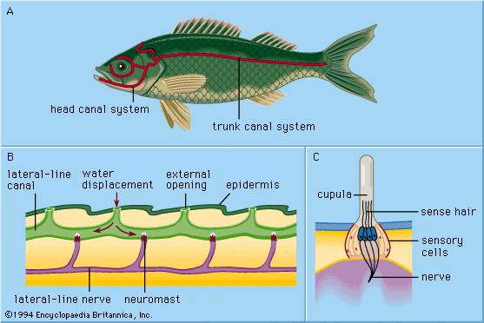
Introduction
It is system of cutaneous sense organ loged in skin present in all craniates
A characteristic set of sense organs found in fishes
Fossil fishes also showed traces of these organs
It is devised for life in water, helps in adjustment to density, pressure & currents of water
Also called mucus canal system
It comprises two components viz. the lateral line canal & the neuromast organs

Slide 3
Lateral Line System
It exists in form of continuous groove, that follows a definite pattern on head & extends along each side of the body to base of tail
Grooves contains the sensory receptors called neuromasts, which are arranged in rows
In Chlamydoselachians neuromasts remain exposed
In Holocephalians, the grooves remain open
In Dipnoans e.g. Protopterus, the canal is partially roofed by bodering denticles & the closed tube of head region opens by minute pores on the surface of the skin
The groove of the canal remains filled with a watery fluid in all the fishes
& their pore contain a mucoid substances
There are many canals in head region, named according to their position:-
Main Lateral line canal
Supra orbital canal
Infra orbital Canal
Temporal canal
Mandibular canal
Preopercular canal

Slide 4
Specialization in lateral Line system in various groups of fishes
In Selachi ( Sharks) it runs along the entire length of the body. The supraorbital canal is much developed on the rostrum & joins the infra orbital canal. A transverse commissure joins the right & left supratemporal canal forming an arch over the occipital region
The hyomandibular fails to meet post orbital and mandibular is completely separated from hyomandibular.
In Actinopterigii, occipital transverse commissure is completely across the middle line
The hyomandibular joins the post orbital dorsally
Jugal is absent, represented by pit organ in Amia
In Dipnoi usual features of Actinopterigii is retained
Preoercular fails to reach thepost orbital but jugal is present
In Teleosts all the cephalic canals viz. the supra orbital, infra orbital & hyomandibular connect with the lateral line canals of the trunk
Supra temporal or occipital canal connects transversely the lateral line canals of the two sides at rear side of the head

Slide 5
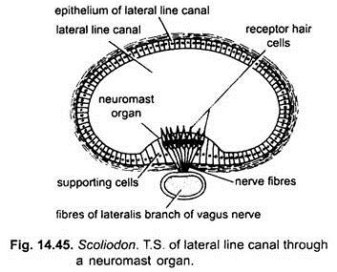
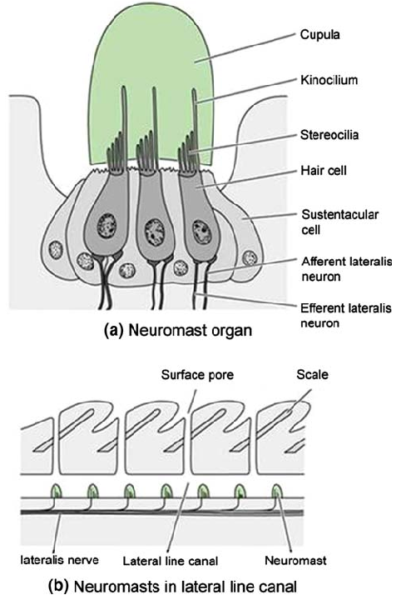
Neuromast Organs
These are receptor units of lateral line system, found in grooves the canal
It consists of two types of cells
The sensory receptor/ hair cells ( Pear shaped, found in centre)
Supporting cells/ Sustentacular cells ( Long & Slender, forms periphery)

Slide 6
Functions
It is receptor for watercurrents, helps fish in orientation
Serves as distant touch receptors
Helps in locating objects at a distance
Respond to pressure changes
Principle of ecolocation is used to detect object in darkness or in turbid medium
Gives the schooling ability to fishes, in which fish of a school reacts to the movement of its closest neighbour.

Slide 7
Special types of Neuromasts
Ampullae of Lorenzini
Pit organs
The vesicles of Savi
Mormyromasts

